Slide 1
Maritime Cybersecurity in the CPSec Lab
Raheem Beyah, Animesh Chhotaray, Frank Li, Ryan Pickren, Anna Raymaker, Ryan Von Brock, Saman Zonouz

Slide 2
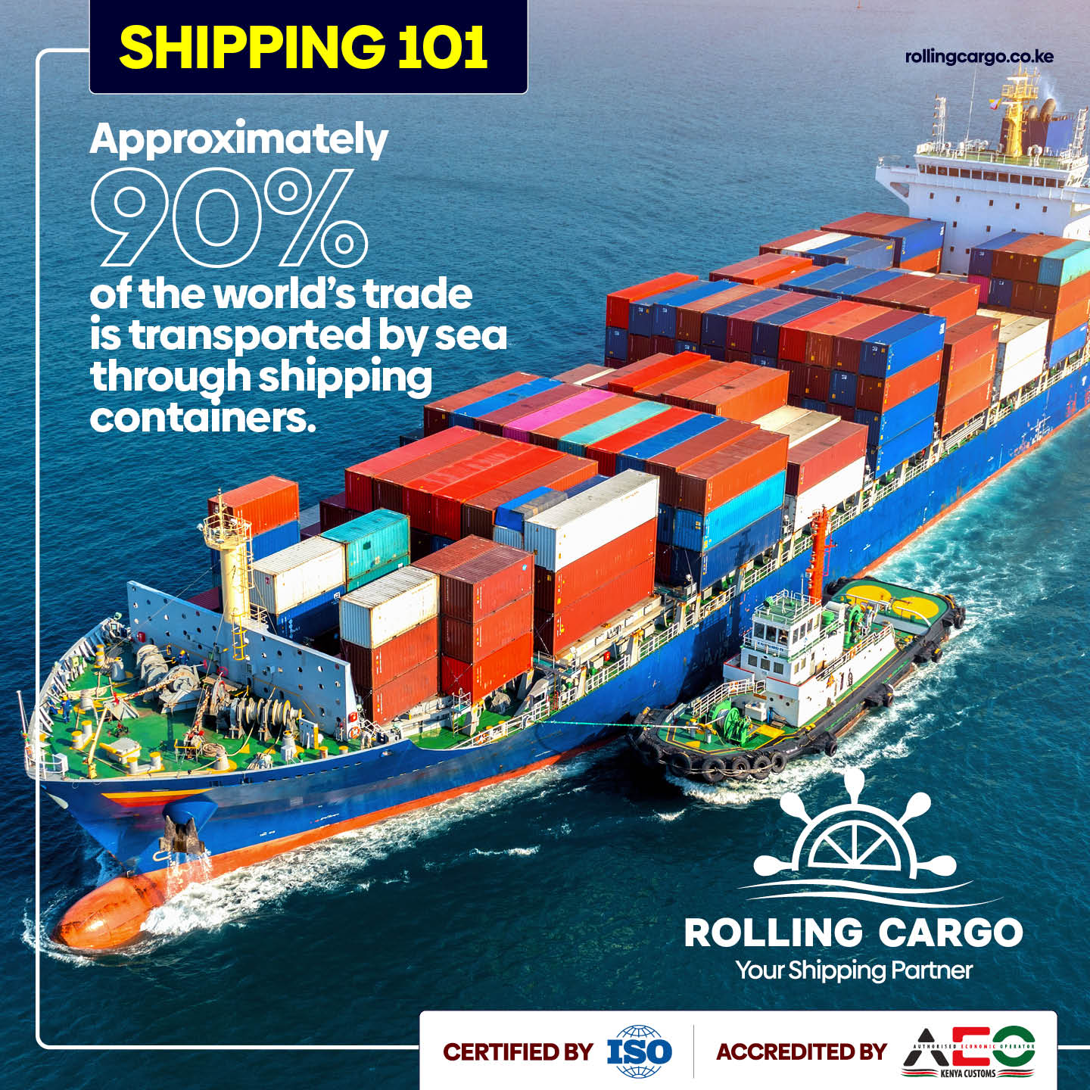
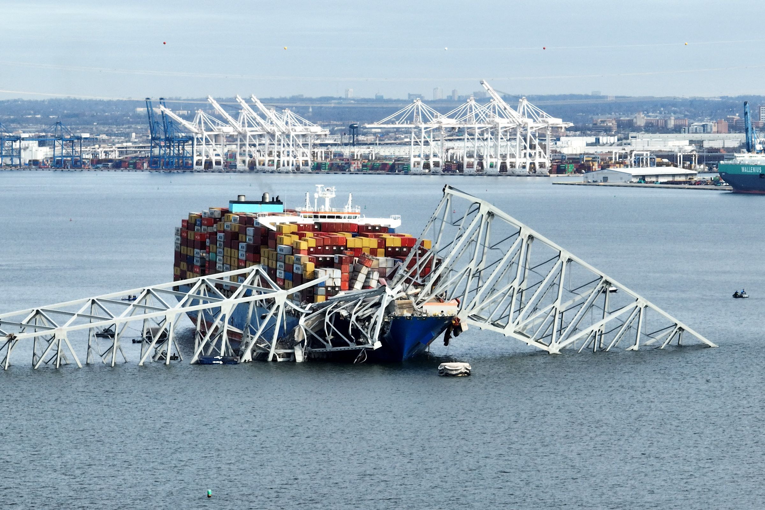
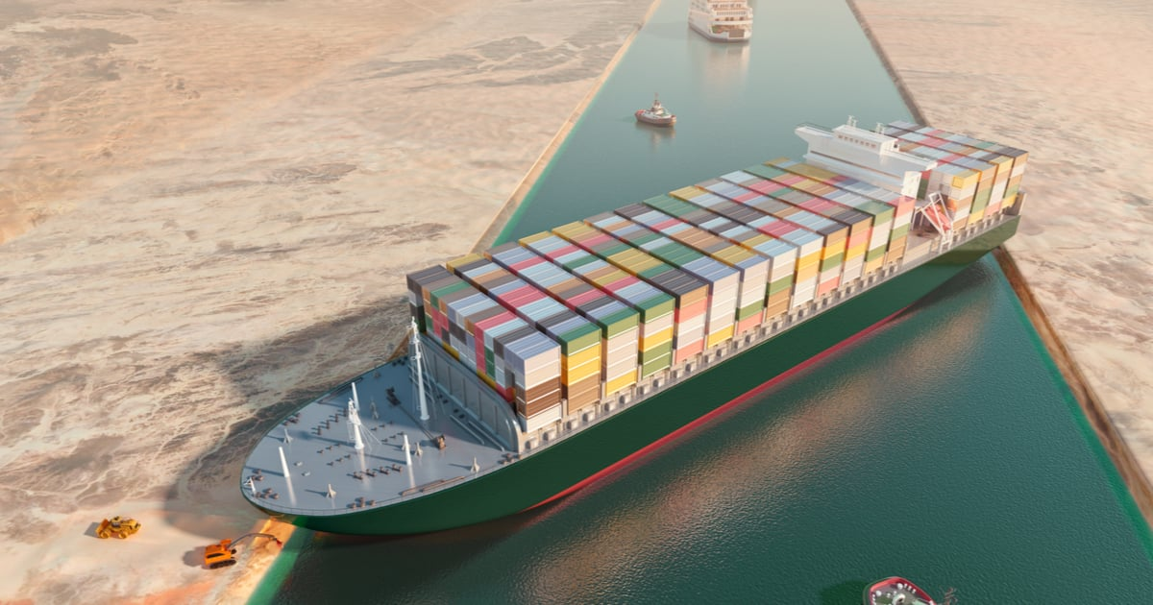
Motivation 1: Impact of Shipping on the Globe
Notes:
Bridge collapses, Canal blockage, 80+ percent of global trade

Slide 3
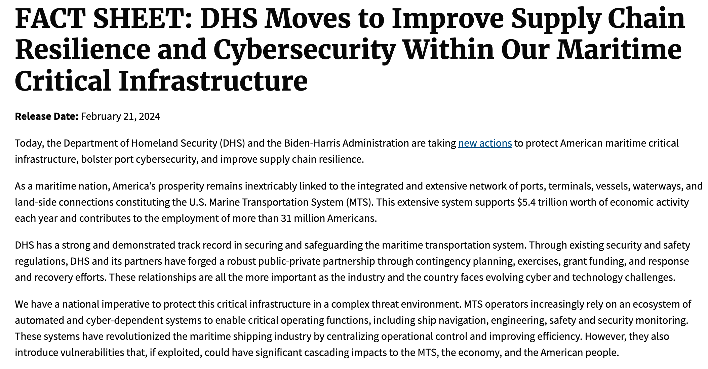
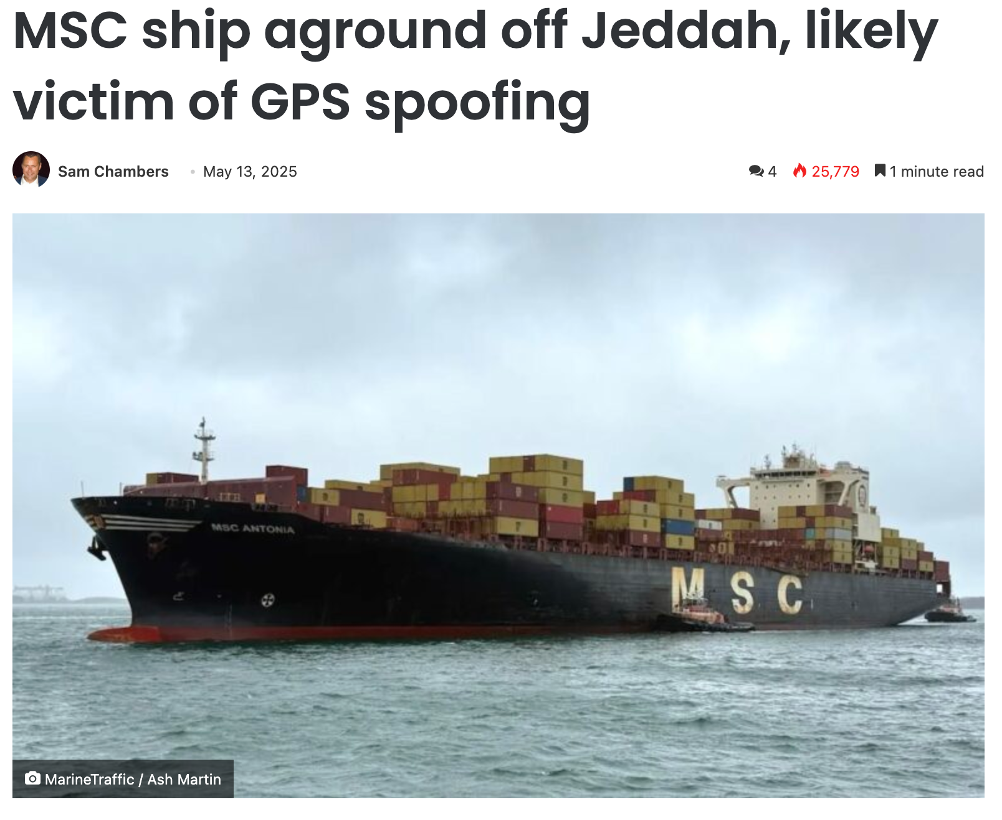
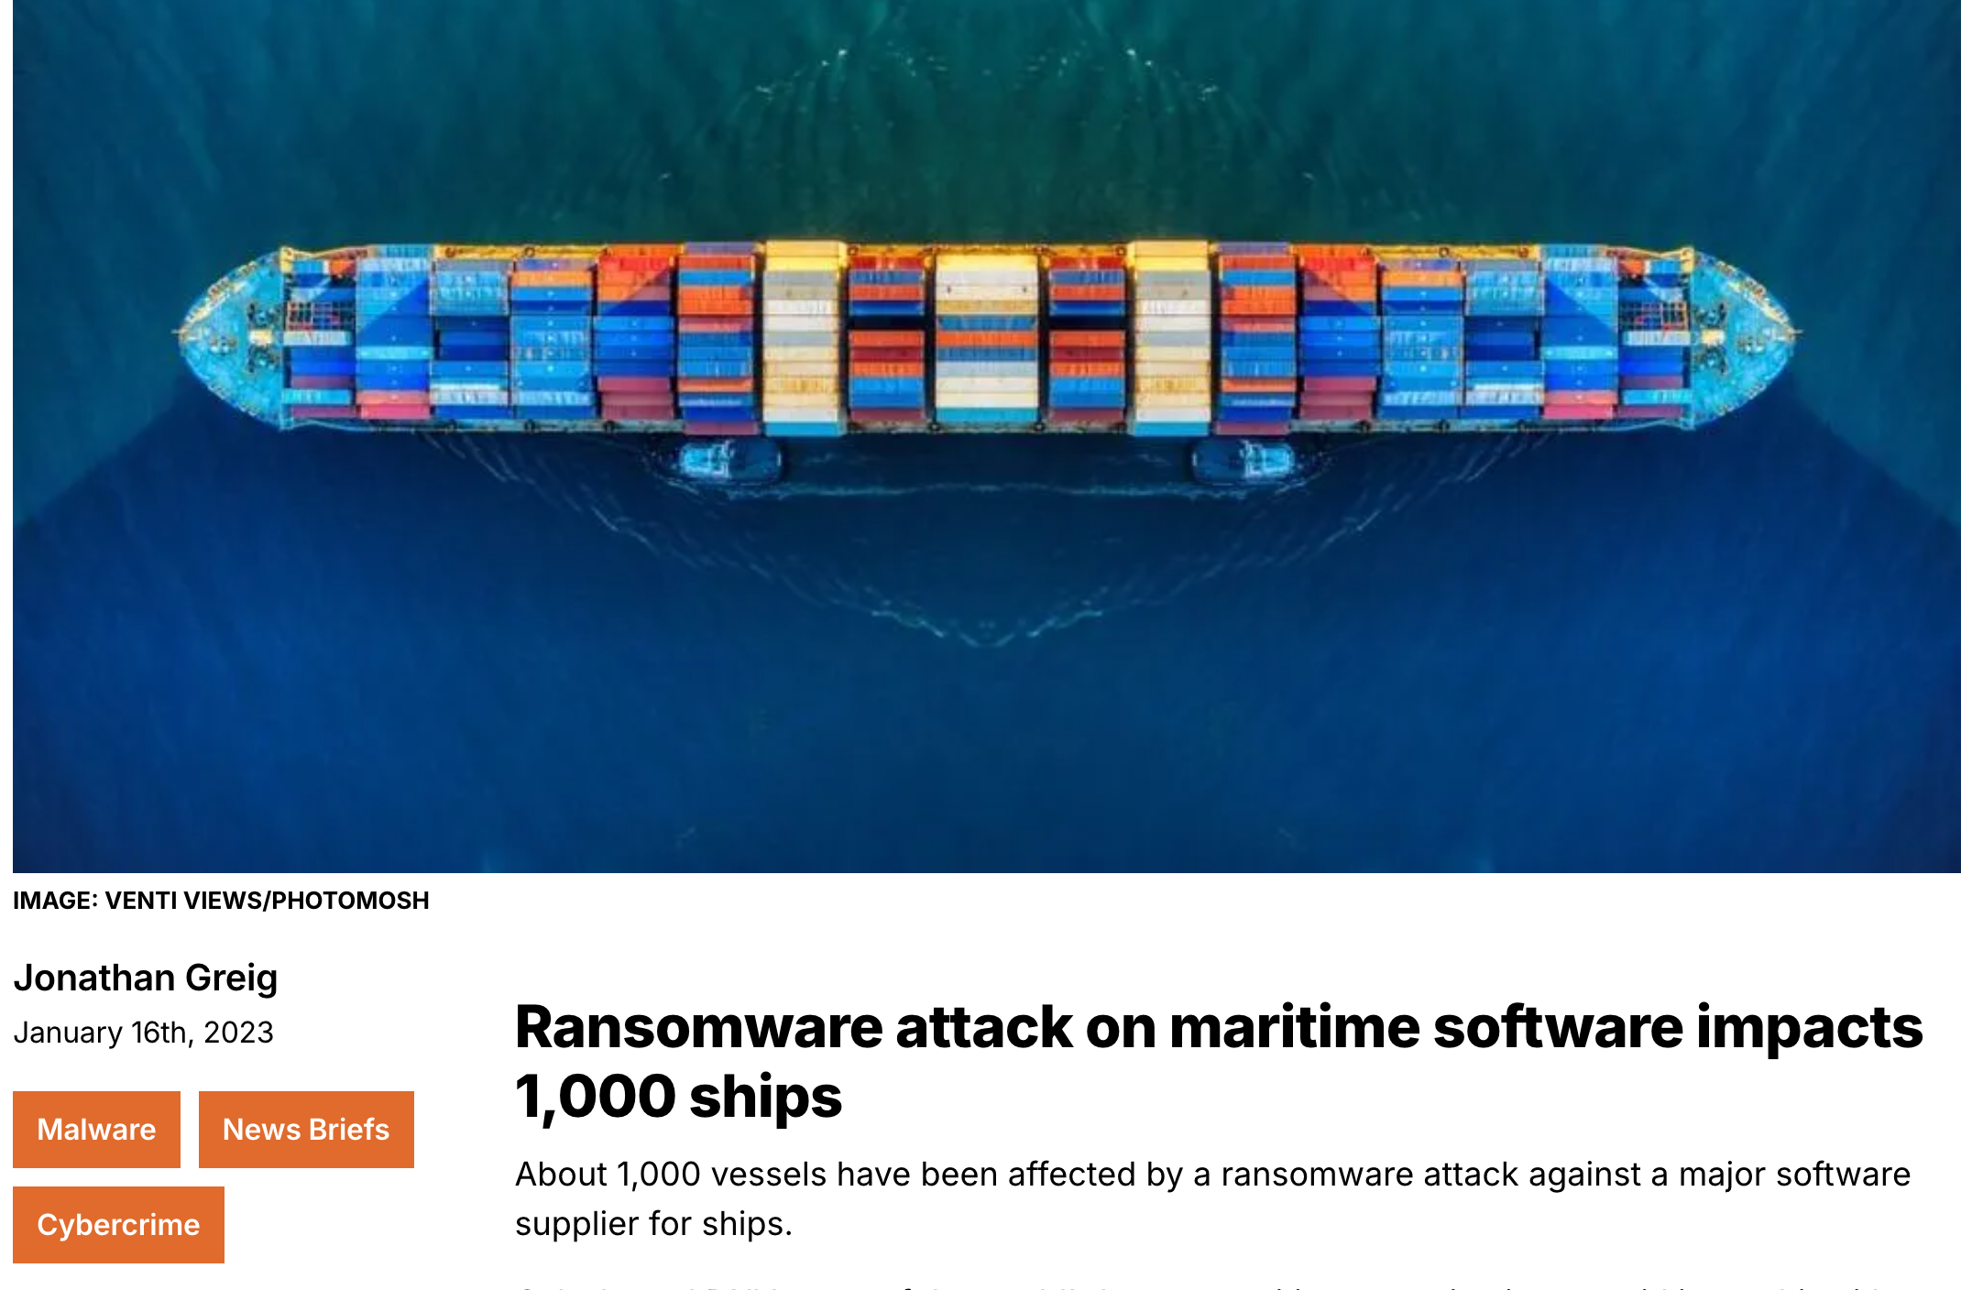
Motivation 2: Increasing Cybersecurity Threats
Notes:
Cybersecurity: Ransomware attacks, GPS Spoofing crashes/taking ships/on land, increased government focus with new regulation

Slide 4
Summary of Work (1.5 years)
Progress
Fully outfitted maritime cybersecurity testbed (live demo today)
User study published at CCS
Mutiny malware research under submission
Invited talks and presentations
TED Talk (Last Spring)
Level Zero Conference (Last Spring)
User study presentation - Taiwan (October)
ICS security talk - (October)
Government of Singapore - testbed demo (November)
Ongoing Projects
Military mariner user study
GPS spoofing measurement study

Slide 5
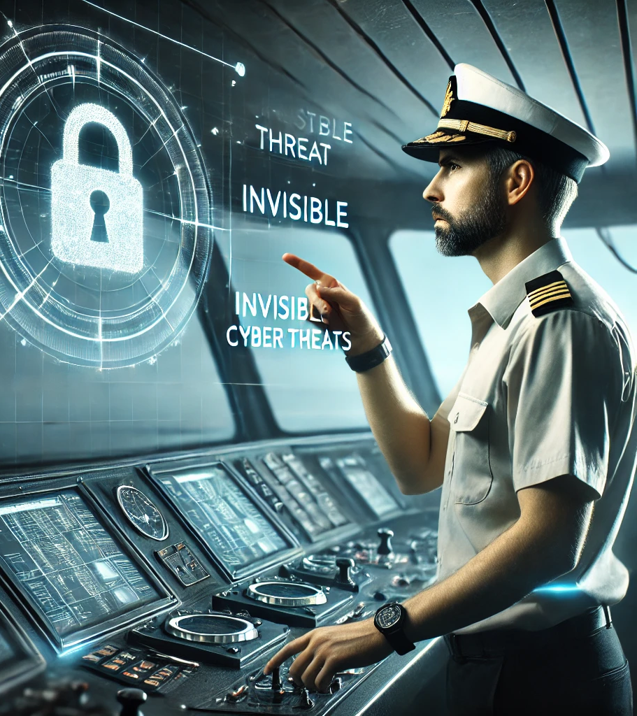
First Published Work: A Sea of Cyber Threats
21 officer-level mariners interviewed
10 reported direct cyberattacks (GPS/AIS spoofing)
21 reported generic training with no OT connection
14 said no cyber response plan on their ship
11 mentioned unsafe cyber practices
Contractor USBs, passwords on keyboards, unmanaged Starlink
11 viewed regulations as burdensome and impractical

Slide 6
Voices from the Mariners
“I’ve been cyber-attacked by Iran… viciously spoofed into Iranian waters.” (P2)
“Our cybersecurity training was just a PowerPoint about flash drives.” (P9)
“If you’re working 12 hours a day for 90 days… after 40 days you’re not as alert and you just don’t care.” (P6)
“I can operate my vessel remotely… if I can do that from a thousand miles away, so can somebody else.” (P4)
“If somebody was smart enough… they could bring the maritime world to a crawl. It’s probably a matter of time.” (P9)

Slide 7
Mutiny Worm: A Self-Spreading Maritime Malware
Ship-to-ship malware that spreads via AIS broadcasts, requiring no internet.
Can manipulate navigation, steering, and onboard systems remotely.
Exposes critical risks in unsecured maritime communication protocols.

Slide 8
Mutiny Enables Global Takeover
Regardless of where Mutiny is deployed, it can reach a major global chokepoint in an average of 29.5 days with only a 1% infection rate of ships.

Slide 9
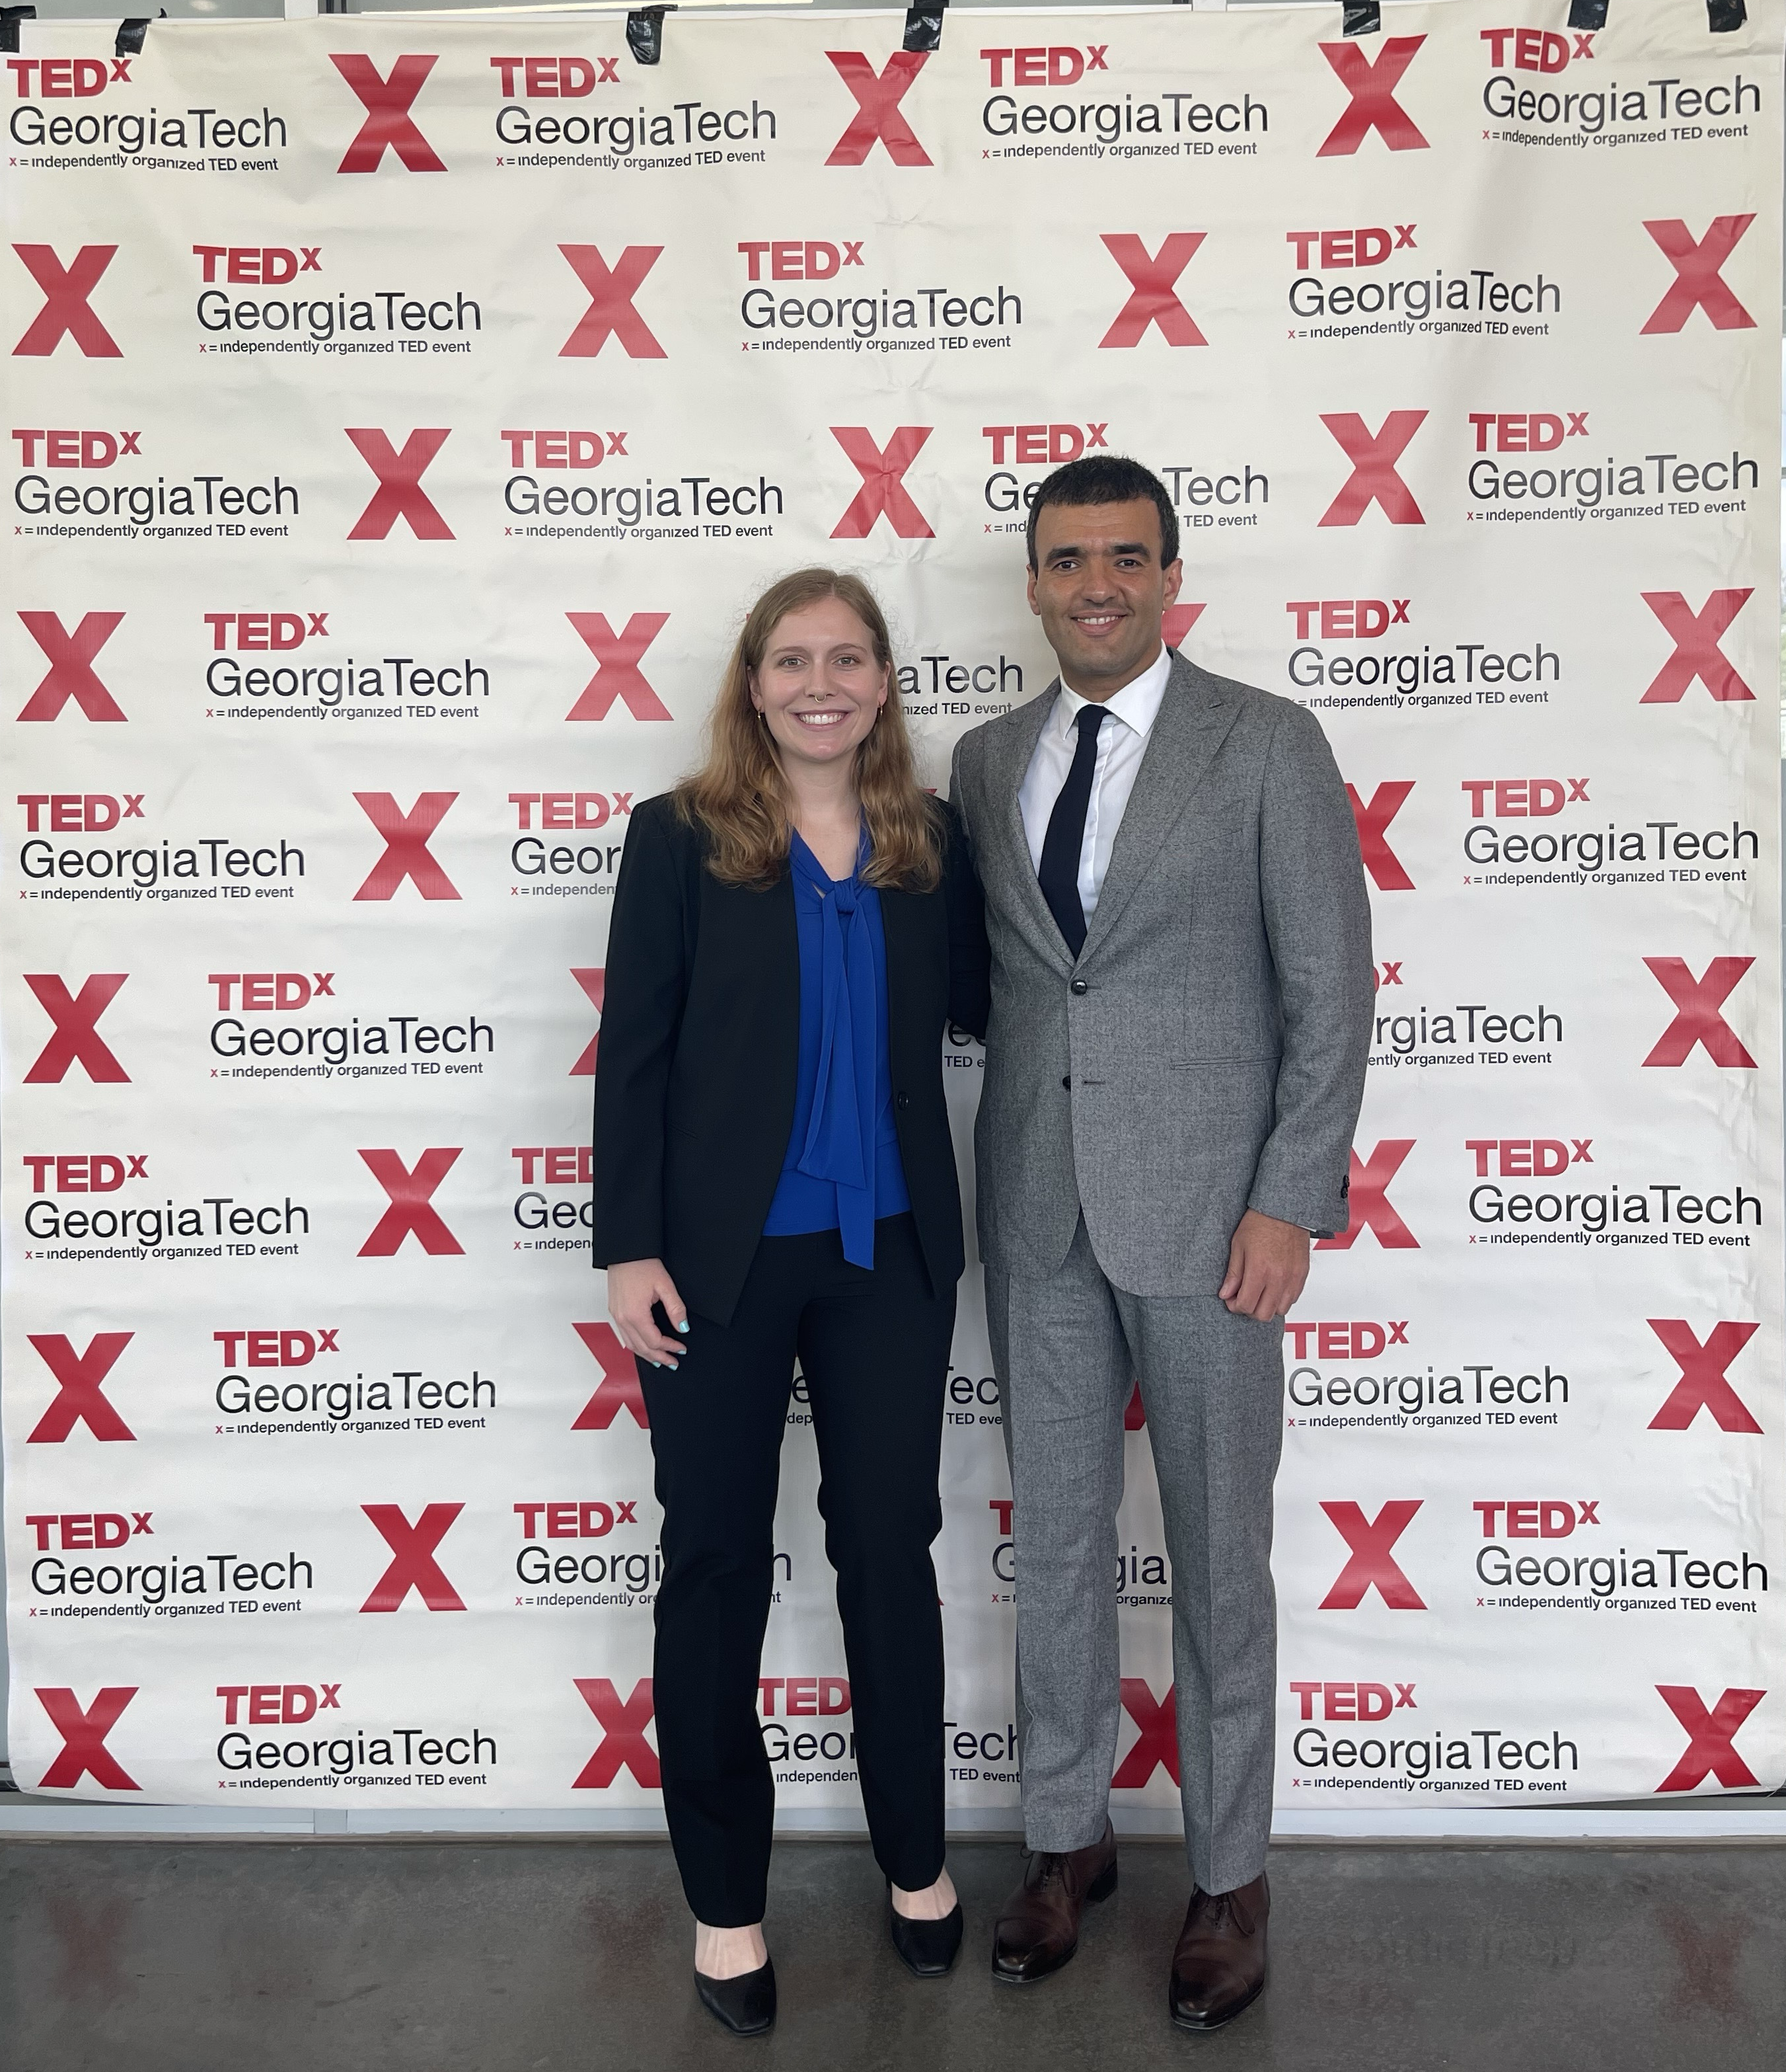
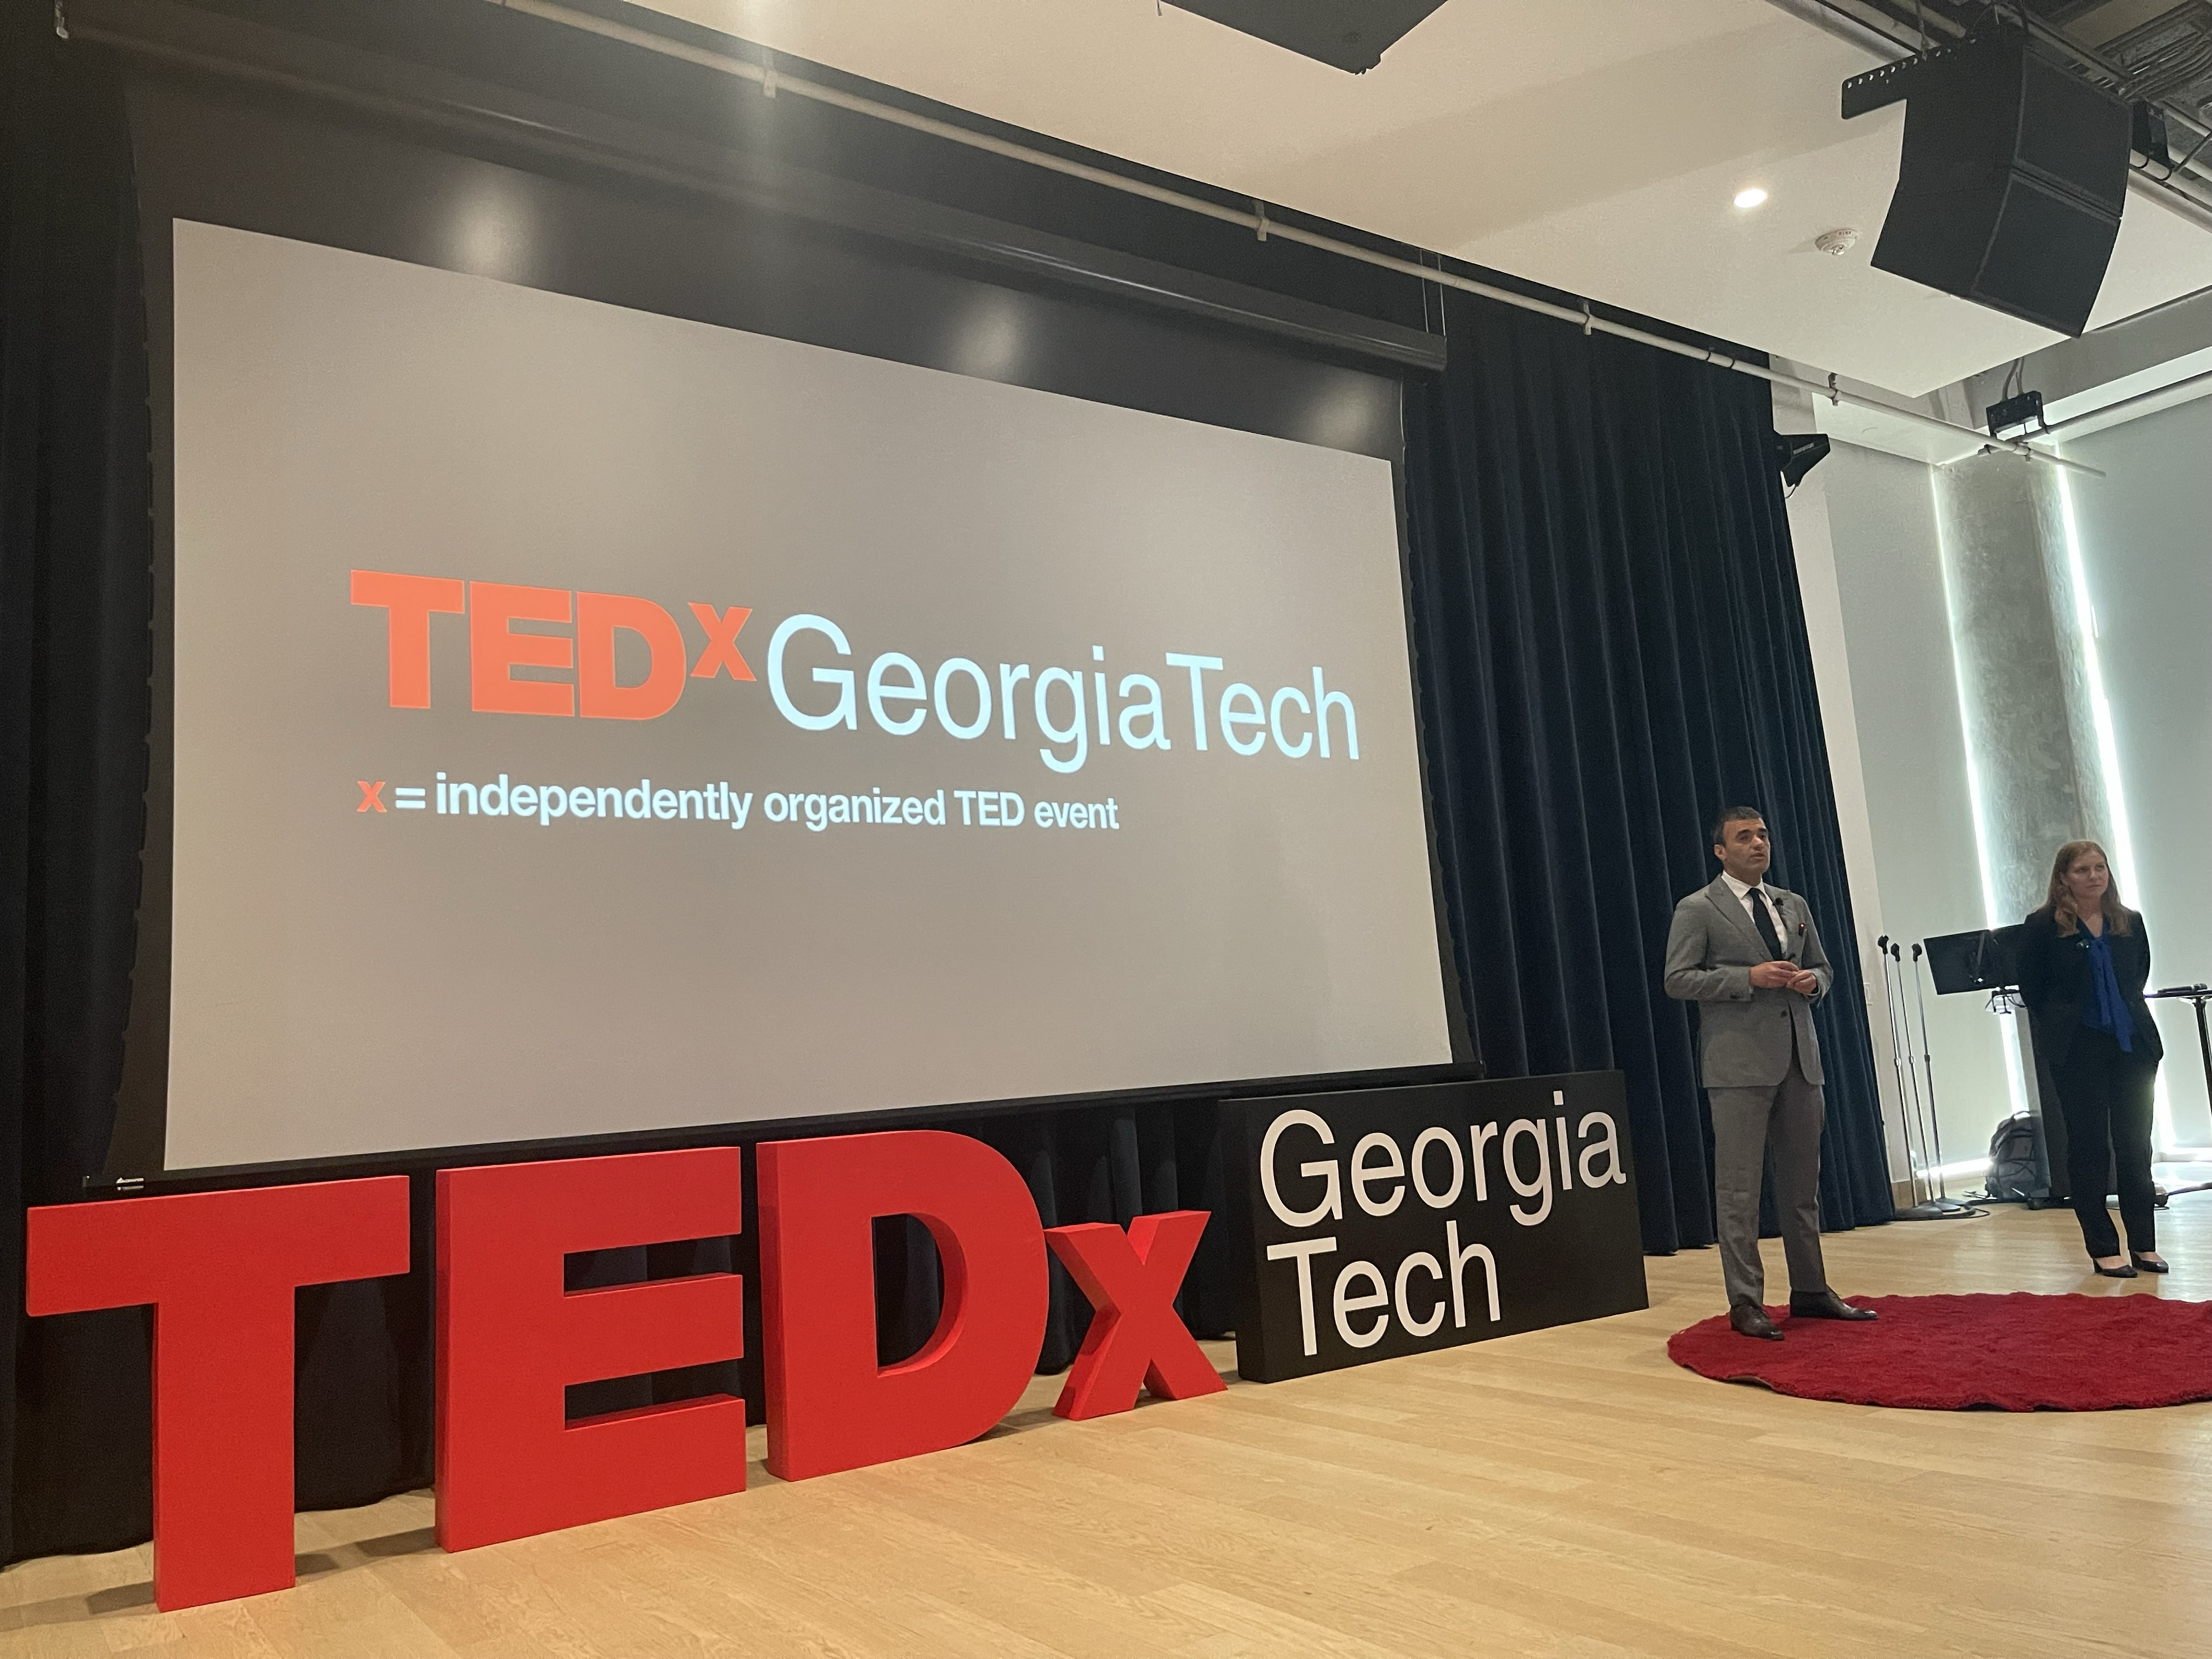
Talks on Maritime Cybersecurity
TED Talk (Last Spring)
CCS presentation - Taiwan (October)
ICS security talk - (October)
Government of Singapore - testbed demo (November)

Slide 10
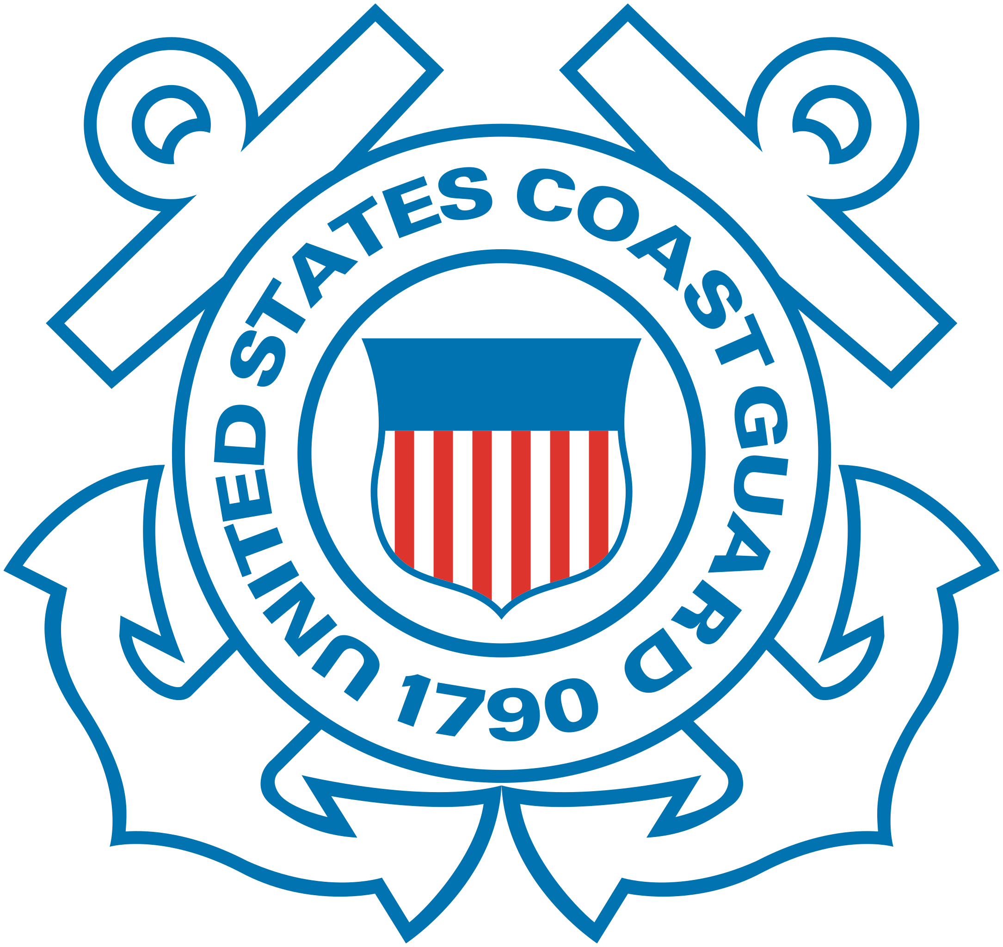
In Progress: Military Mariner User Study
5 interviews with Coast Guard deck watch officers
Early Insights:
Military systems introduce new vulnerabilities and high consequences.
Robust non-cyber training mitigates some vulnerabilities.
Rank may override technical expertise.
Cybersecurity is an individual responsibility—though abstractly understood.
“You could cripple a vessel or you could cause World War III if you wanted to.” –B4

Slide 11
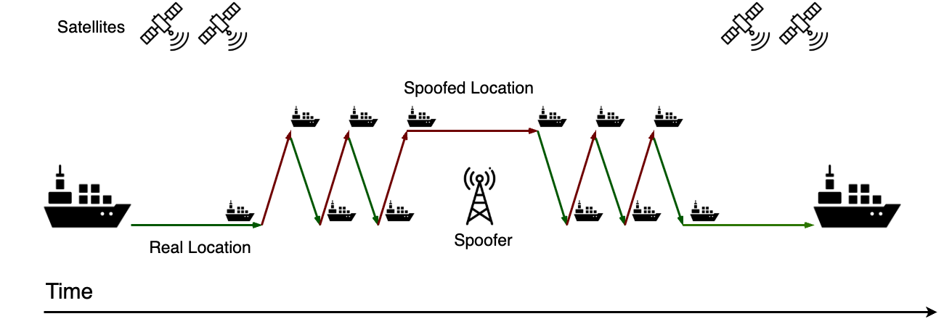
In Progress: GPS Spoofing Measurement

Slide 12
Recent publications leveraging the testbeds
CCS'25: A Sea of Cyber Threats: Maritime Cybersecurity from the Perspective of Mariners Anna Raymaker, Akshaya Kumar, Miuyin Yong Wong, Ryan Pickren, Animesh Chhotaray, Frank Li, Saman Zonouz, Raheem Beyah
CCS'25: One Video to Steal Them All: 3D-Printing IP Theft through Optical Side-Channels, Twisha Chattopadhyay, Fabricio Ceschin, Marco Garza, Dymytriy Zyunkin, Animesh Chhotaray, Aaron Stebner, Saman Zonouz, Raheem Beyah
CCS'25: The Challenges and Opportunities with Cybersecurity Regulations: A Case Study of the US Electric Power Sector, Sena Sahin, Burak Sahin, Robin Berthier, Kate Davis, Saman Zonouz, Frank Li
CCS'24: Release the Hounds! Automated Inference and Empirical Security Evaluation of Field-Deployed PLCs using Active Network Data, Ryan Pickren, Animesh Chhotaray, Frank Li, Saman Zonouz, Raheem Beyah
CCS'24: ERACAN: Defending Against a Game-Changing CAN Threat Model, Zhaozhou Tang, Khaled Serag, Berkay Celik, Saman Zonouz, Raheem Beyah, Dongyan Xu (Distinguished Paper Award)
NDSS'24: Compromising Industrial Processes using Web-Based Programmable Logic Controller Malware, Ryan Pickren, Tohid Shekari, Saman Zonouz, Raheem Beyah

Slide 13
Currently ongoing funded projects…
NSF CHORUS $7M Automotive
Hyundai $280K Automotive
GDoT $100K Automotive
Brusa HiPower (CH) Automotive
DOD BA-BOM $3M Controller security
GTRI/SEI IRAD $160K Controller security
GTRI IRAD $270K Controller security
DHS $500K (terminated) Resilience
DOE DerGuard $4.2M Power grid
DOE Phrensics $4.6M Power grid
DOE SCORE $250K Power grid
DOE INL/CIE $300K Power grid
DOE Sandia Labs $70K Power grid
AI-Manufacturing $65M Manufacturing
NSF SaTC $600K CPS Deception
Accenture $200K AI-based CPS

Slide 14
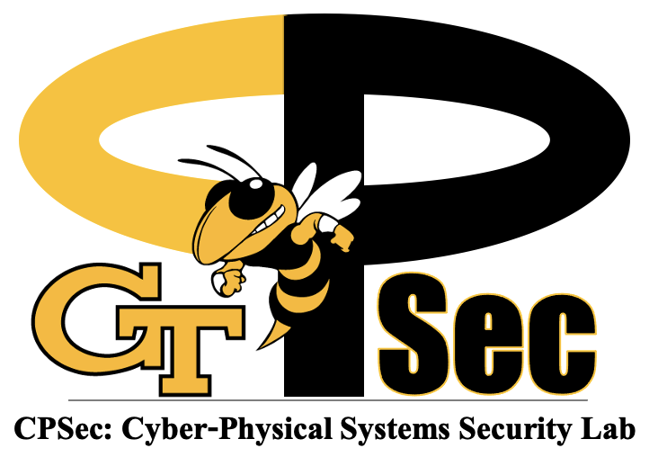

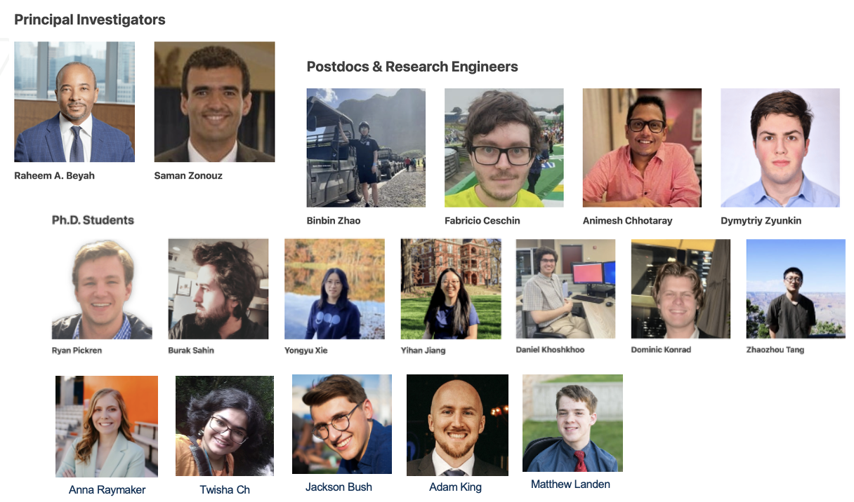
CPSec Lab @ Georgia Tech
Cyber-Physical Systems Security Research Lab
Notes:
Almost all I talked about, is done by my research group, CPSec Lab, shown here through a drone-captured photo!

Slide 15
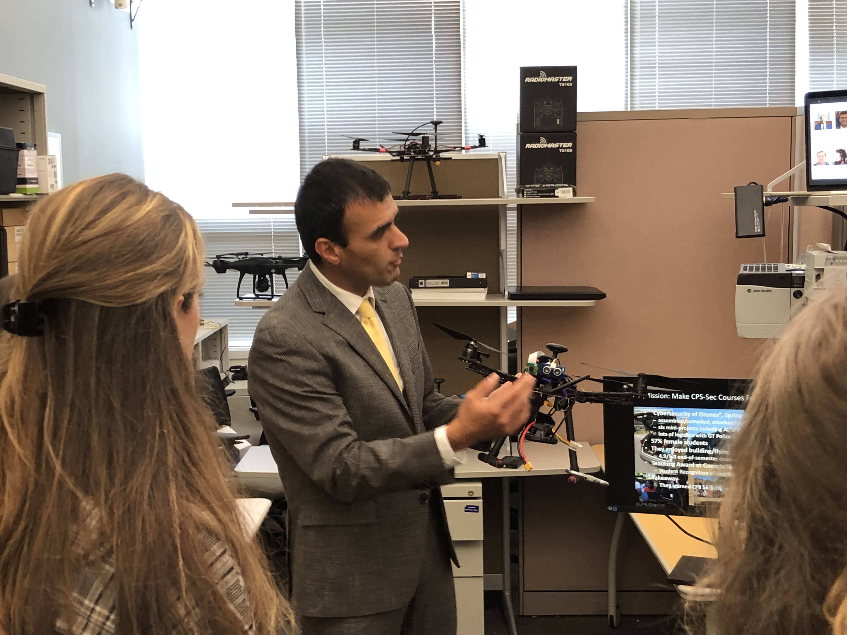
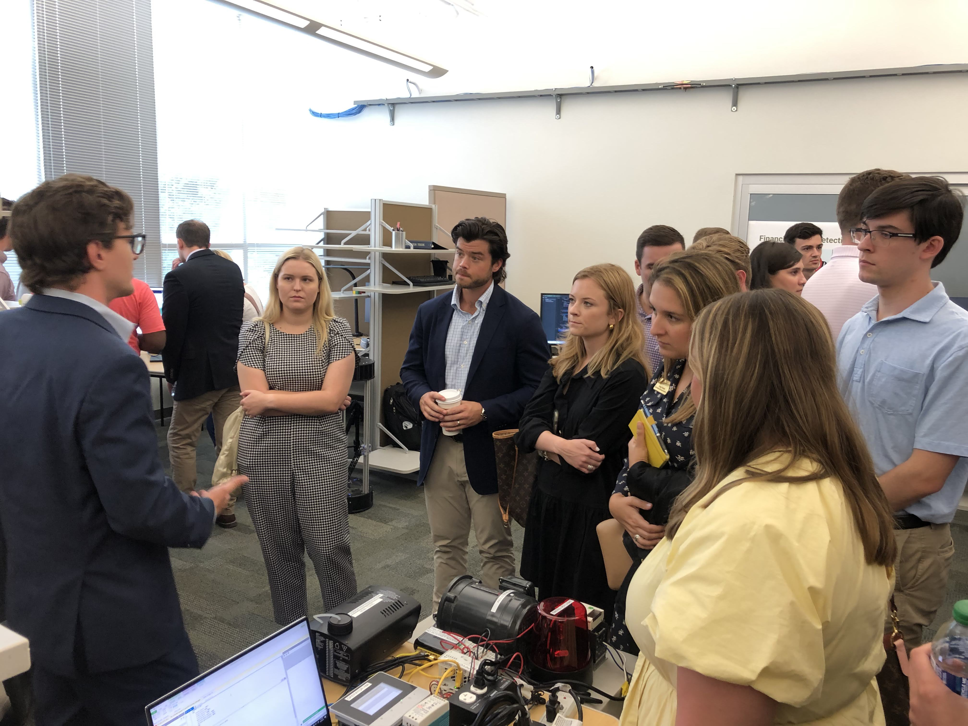

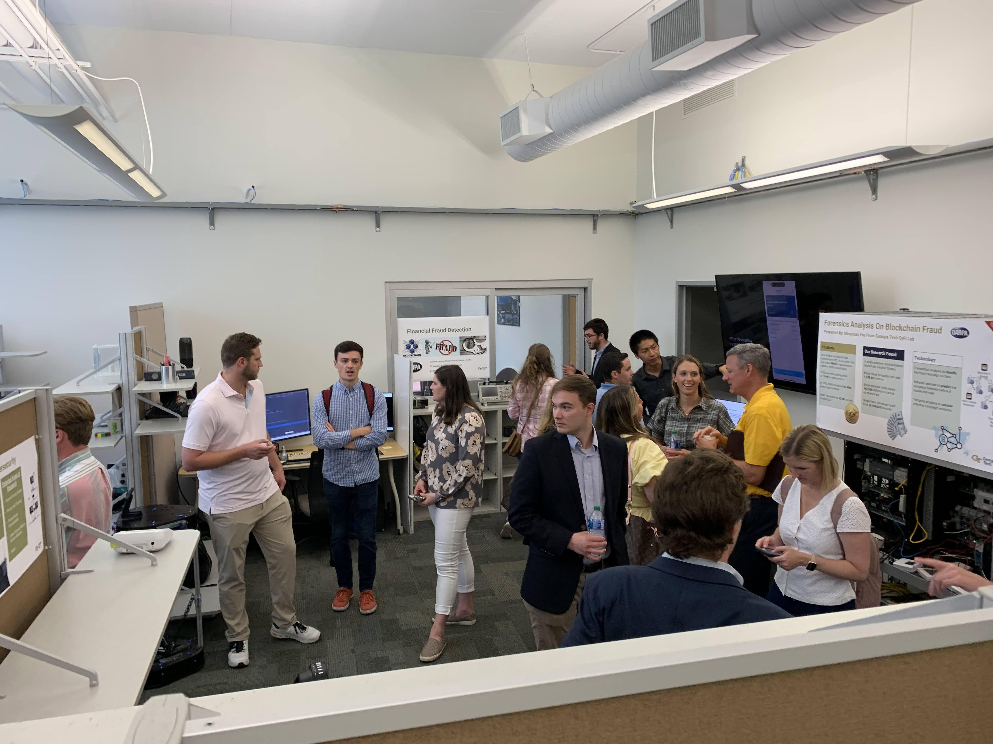
U.S. Congressional Visit

Slide 16
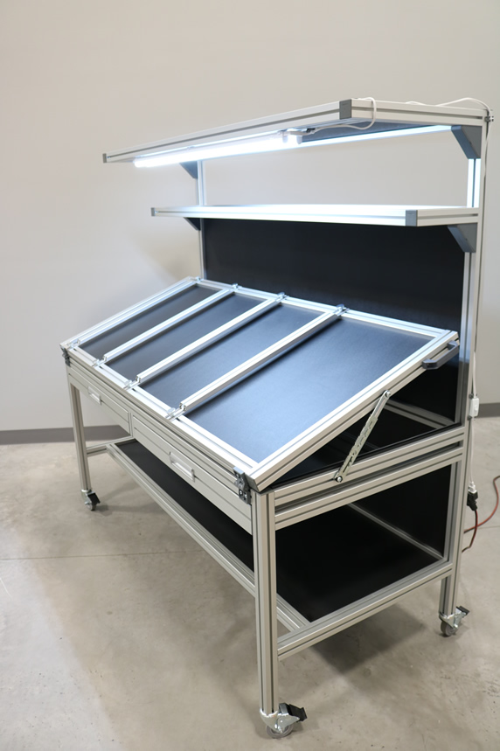
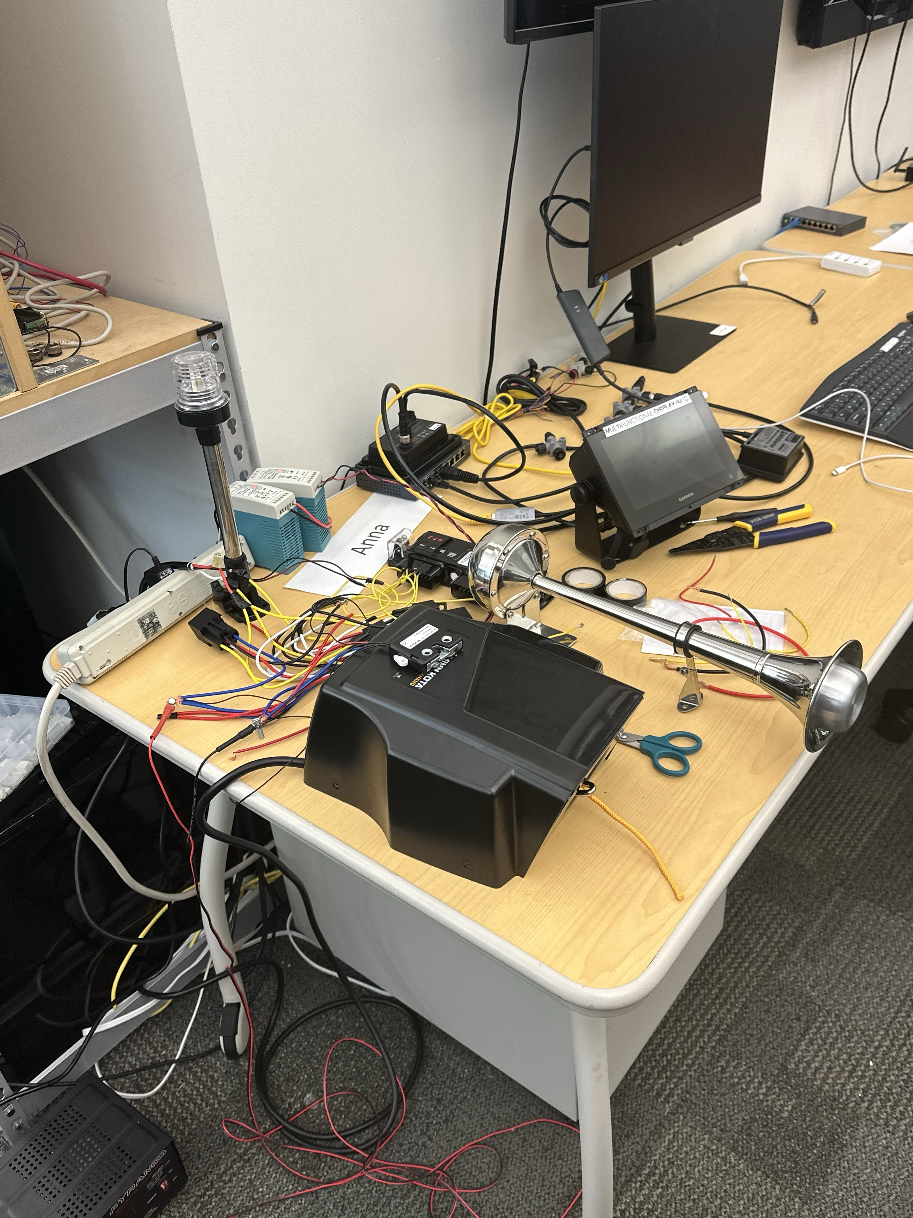
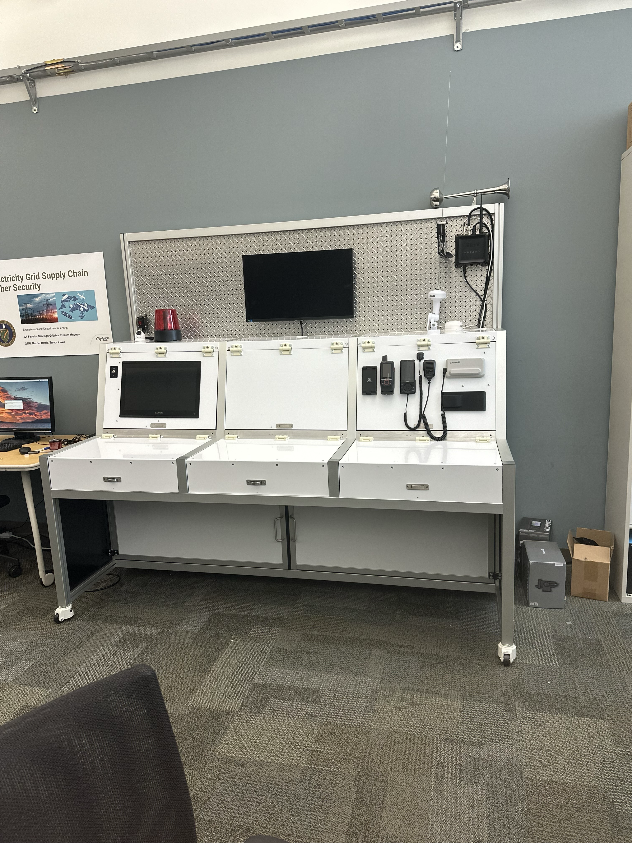
Maritime Cybersecurity Testbed Progress

Slide 17
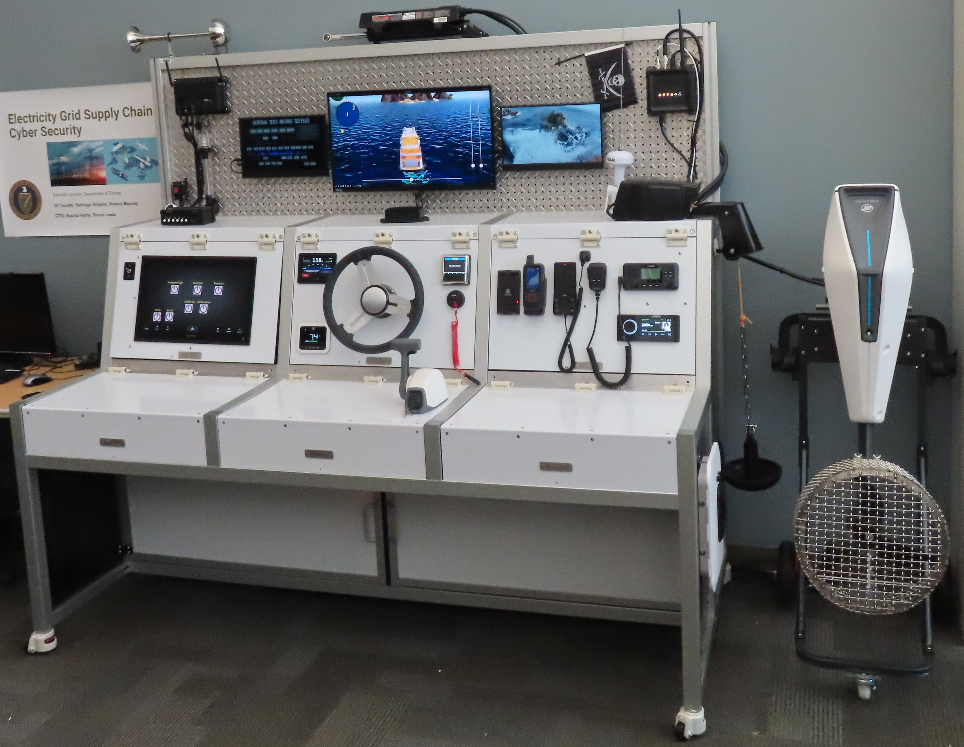
Maritime Cybersecurity Testbed Demo!

